Slide 1

UNIVERSITY INSTITUTE OF ENGINEERING
COMPUTER SCIENCE ENGINEERING
Bachelor of Engineering (Computer Science & Engineering)
Subject Name: Big Data Analytics
Subject Code: 20CST-471
Descriptive and Predictive analytics
Mapped with CO4
Prepared By:
Er. Ankita Sharma
DISCOVER . LEARN . EMPOWER

Slide 2
Descriptive and Predictive analytics
Descriptive analytics involves analyzing historical data to understand and summarize what has happened in the past. It focuses on providing insights into the patterns, trends, and characteristics of data.
Key Characteristics:
Objective: Descriptive analytics aims to provide a clear and objective summary of historical data, answering questions such as "What happened?" and "What is the current state?"
Visualization: Visualization tools like charts, graphs, and dashboards are commonly used to present descriptive analytics results in an easily understandable format.

Slide 3
Use Cases:
Sales Reporting: Analyzing historical sales data to understand patterns, identify peak seasons, and evaluate the performance of products.
Website Analytics: Examining website traffic data to understand user behavior, page views, and popular content.
Financial Reporting: Summarizing financial data to generate reports on revenues, expenses, and profitability.

Slide 4
Predictive Analytics:
Definition: Predictive analytics involves using statistical algorithms and machine learning techniques to analyze historical data and make predictions about future events or trends.
It goes beyond describing what happened to answer the question "What is likely to happen in the future?

Slide 5
Key Characteristics:
Forecasting: Predictive analytics is focused on forecasting future outcomes based on patterns and relationships identified in historical data.
Probability: Predictions are often expressed in terms of probabilities or likelihoods, providing insights into potential future scenarios.
Complex Algorithms: Machine learning algorithms, such as regression, decision trees, and neural networks, are commonly used in predictive analytics to build models that can make accurate predictions.

Slide 6
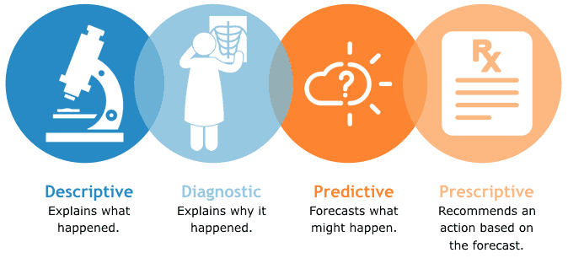

Slide 7
Use Cases:
Demand Forecasting: Predicting future product demand based on historical sales data, seasonality, and other relevant factors.
Churn Prediction: Identifying customers who are likely to churn or stop using a service based on their past behavior and characteristics.
Credit Scoring: Assessing the creditworthiness of individuals by predicting the likelihood of default on a loan based on historical financial data.

Slide 8
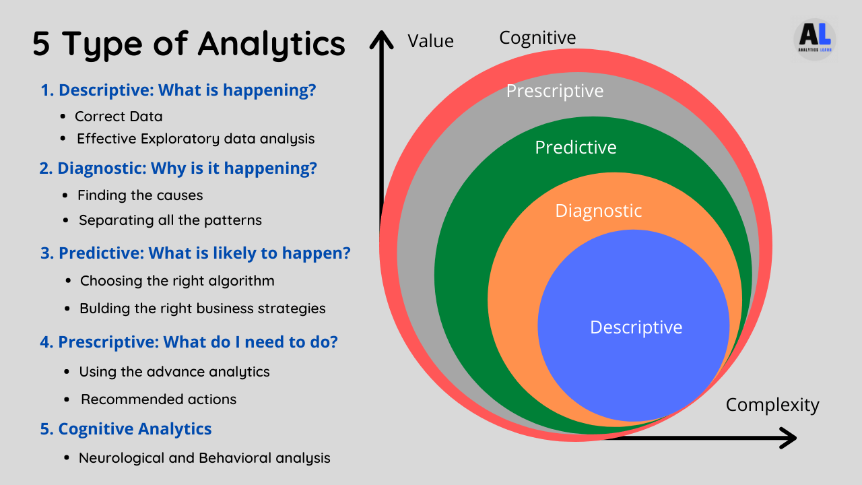

Slide 9
Relationship between Descriptive and Predictive Analytics:
Sequential Process: Descriptive analytics often serves as a foundation for predictive analytics. By understanding historical data through descriptive analytics, organizations can identify patterns that form the basis for predictive models.
Complementary: While descriptive analytics helps answer "what happened" questions, predictive analytics extends this understanding to "what is likely to happen" in the future.
Informed Decision-Making: Together, these analytics approaches contribute to informed decision-making. Descriptive analytics provides context, and predictive analytics offers insights that support proactive and strategic decision-making.

Slide 10
Thankyou

